Slide 1
PROJECT TITLE
HOUSE PRICE PREDICTION
BY – KHUSHBOO GUPTA

Slide 2
Problem Statement
Houses are one of the necessary need of each and every person around the globe and therefore housing and real estate market is one of the markets which is one of the major contributors in the world’s economy. It is a very large market and there are various companies working in the domain. Data science comes as a very important tool to solve problems in the domain to help the companies increase their overall revenue, profits, improving their marketing strategies and focusing on changing trends in house sales and purchases. Predictive modelling, Market mix modelling, recommendation systems are some of the machine learning techniques used for achieving the business goals for housing companies. Our problem is related to one such housing company.
A US-based housing company named Surprise Housing has decided to enter the Australian market. The company uses data analytics to purchase houses at a price below their actual values and flip them at a higher price. For the same purpose, the company has collected a data set from the sale of houses in Australia. The data is provided in the CSV file below.
The company is looking at prospective properties to buy houses to enter the market. You are required to build a model using Machine Learning in order to predict the actual value of the prospective properties and decide whether to invest in them or not. For this company wants to know:
• Which variables are important to predict the price of variable?
• How do these variables describe the price of the house?

Slide 3
Technical Requirements
Data contains 1460 entries each having 81 variables.
Data contains Null values. You need to treat them using the domain knowledge and your own understanding.
Extensive EDA has to be performed to gain relationships of important variable and price.
Data contains numerical as well as categorical variable. You need to handle them accordingly.
You have to build Machine Learning models, apply regularization and determine the optimal values of Hyper Parameters.
You need to find important features which affect the price positively or negatively.
Two datasets are being provided to you (test.csv, train.csv). You will train on train.csv dataset and predict on test.csv file.

Slide 4
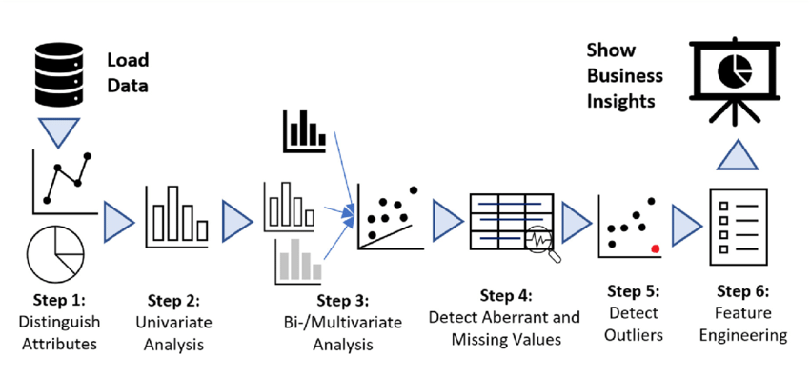
Exploratory Data Analysis

Slide 5
Steps Involved
Load the dataset
Distinguish the attributes
Checking the null values & handled them accordingly
Do the EDA
Check the correlation & removing the outliers
Feature Engineering – Find the best machine learning model to get the best accuracy.
Check the cross val score & perform the hypermeter tuning.
Save the model & check the predicted & actual values using the best saved model.
Now, predict the sale price for the given dataset.

Slide 6
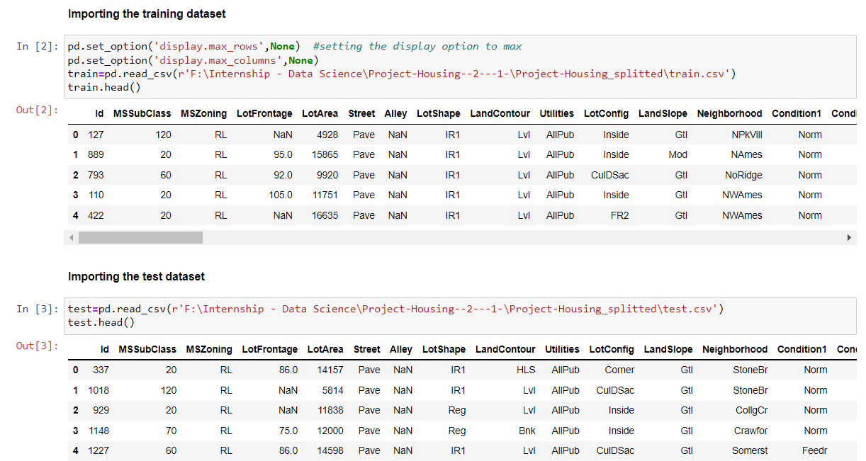
Load the dataset

Slide 7
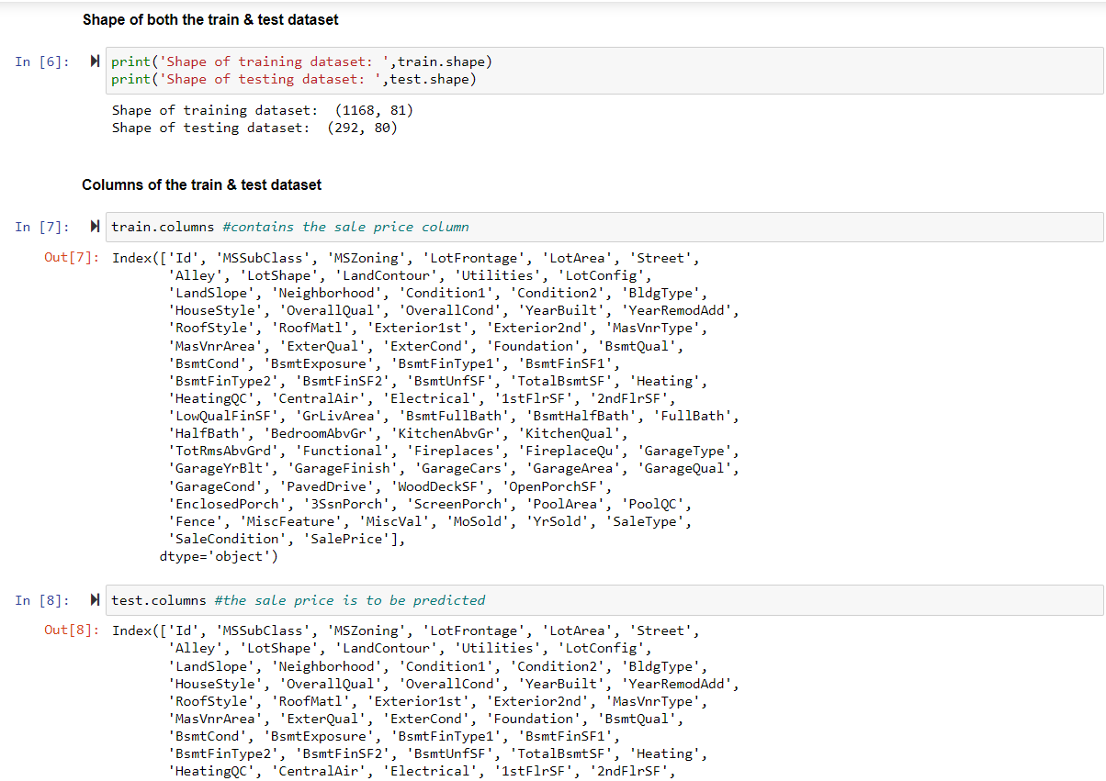
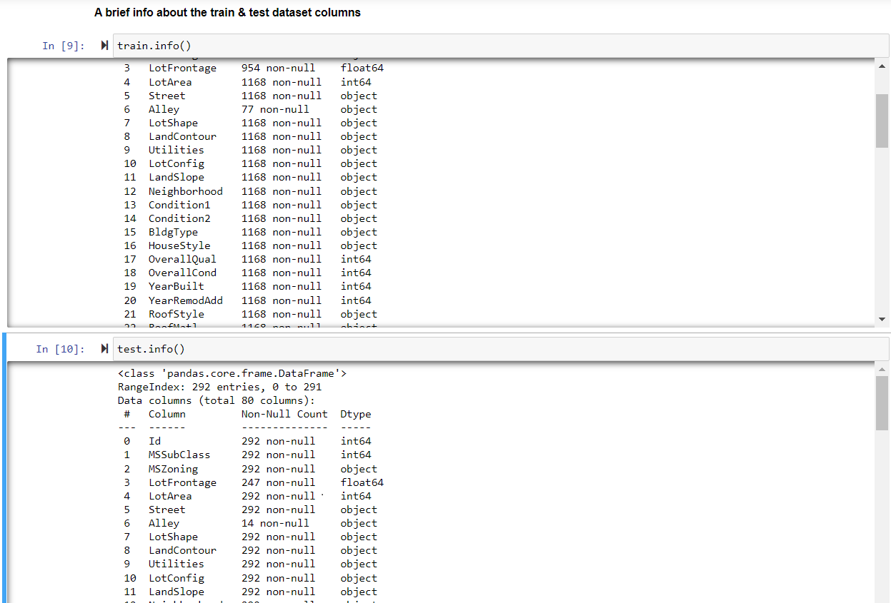
Checking the Attributes
First & last five rows of both the dataset
Shape of the datasets
Columns present in the datasets
Brief info about the datasets
Null values present in both the dataset

Slide 8
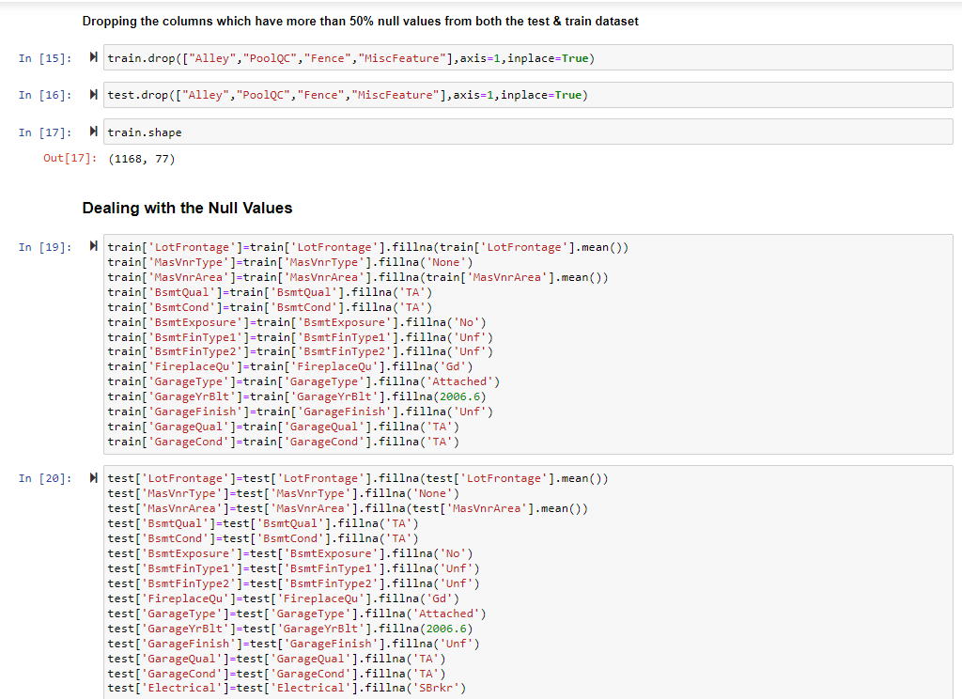
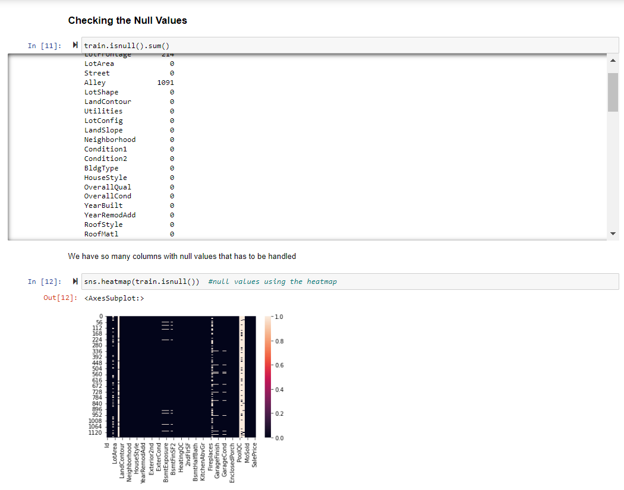
Dealing with the Null Values

Slide 9
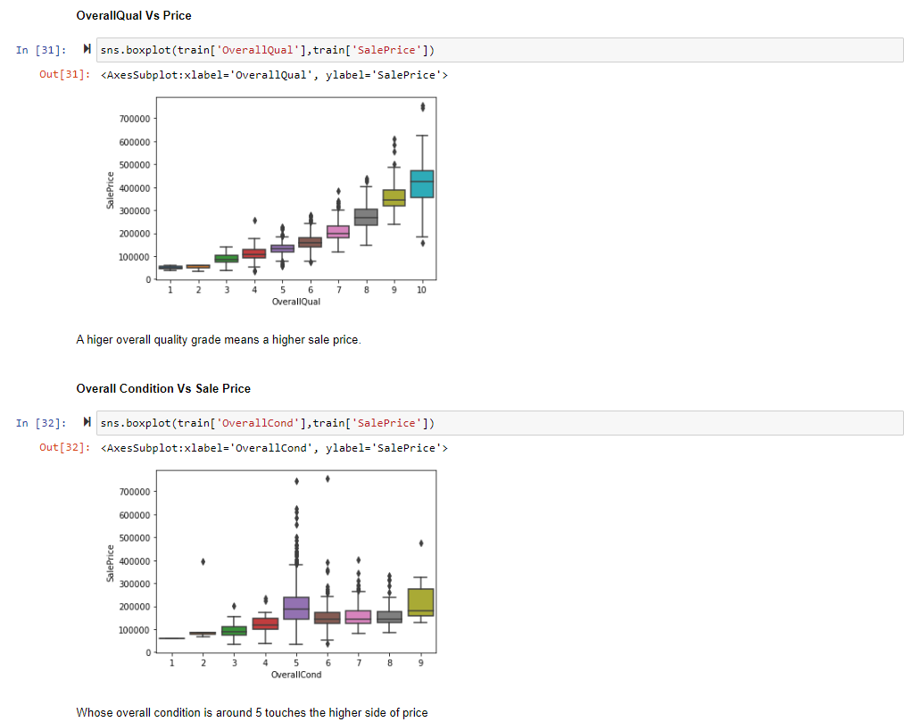
EDA
Which street house has higher price?
House in Pave street have higher sale price.
What type of Land Contour has higher sale price?
HLS type houses has higher sale price
What Lot configuration is in higher demand?
CulDSac followed by FR3 lot configuration are in higher demand
Whose neighborhood increased the sale price?
The one who has NoRidge & NridgHt in their neighborhood has the high sale price. The one who has NPkVill & Bluestee in the nighborhood are on the lower side
Which house style has high sale price?
The 2.5Fin has the highest sale price followed by 2Story and 1.5Unf has the lowest sale price
What type of building has high sale price?
TwnhsE & 1Farm type buildings are on higher side
Which roof style & material increases the price of a house?
A house with Gable roof style and made of WdShngl shown up a with higher sale price

Slide 10
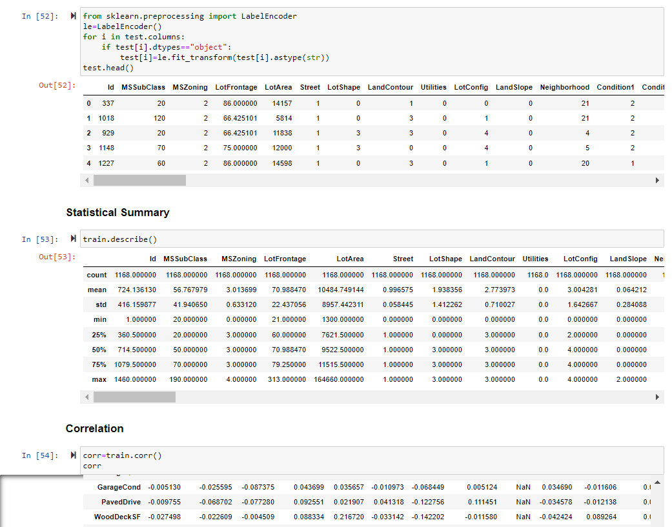
After Doing the EDA, let’s do the next step
We have some categorical data as well which has to be handled as ML model doesn’t take the string values. We will do that with the help of Label Encoding which provides a separate value to every category in each column. This has to be done with both the dataset.
Afterwards, using the describe function we will elaborate the statistical summary of the dataset which contains the count, min, max, standard deviation, mean etc. of every column.
Find the correlation between each column
Checking the skewness.
Removing the outliers.

Slide 11
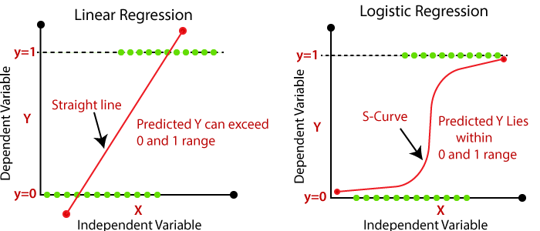
Is this a Regression problem or Classification problem?
By looking at the output i.e. ‘Sale Price’, this is a continuous data not a categorical output so we go for the regression machine learning algorithms to predict the Sale Price.
What does Regression mean?
In Regression, the output is continuous data. In this method, we predict the trends of training data based on the features. The result does not belong to a certain category or class, but it gives a numeric output that is a real number. For example, predicting House Prices is based on certain features like size of the house, location of the house, and no. of floors, etc.

Slide 12
Used Regression Algorithms
Linear Regression
from sklearn.linear_model import LinearRegression
Decision Tree Regressor
from sklearn.tree import DecisionTreeRegressor
Support Vector Regressor
from sklearn.svm import SVR
Kneighbor Regressor
from sklearn.neighbors import KNeighborsRegressor
Random Forest Regressor
from sklearn.ensemble import RandomForestRegressor
MODEL | ACCURACY
Linear Regression | 0.878165525517784
Decision Tree Regressor | 0.7819521438284093
Support Vector Regressor | -0.044480459746993
Kneighbor Regressor | 0.6839964008801616
Random Forest Regressor | 0.8815066126350098

Slide 13
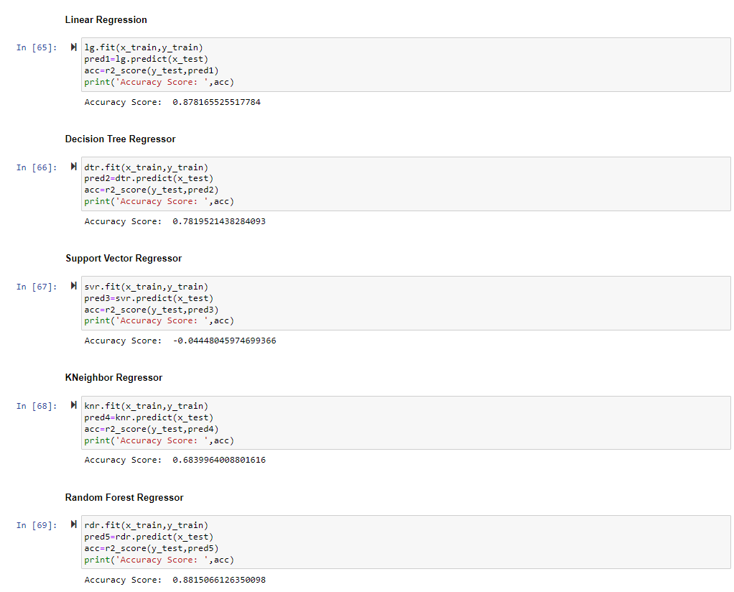

Slide 14
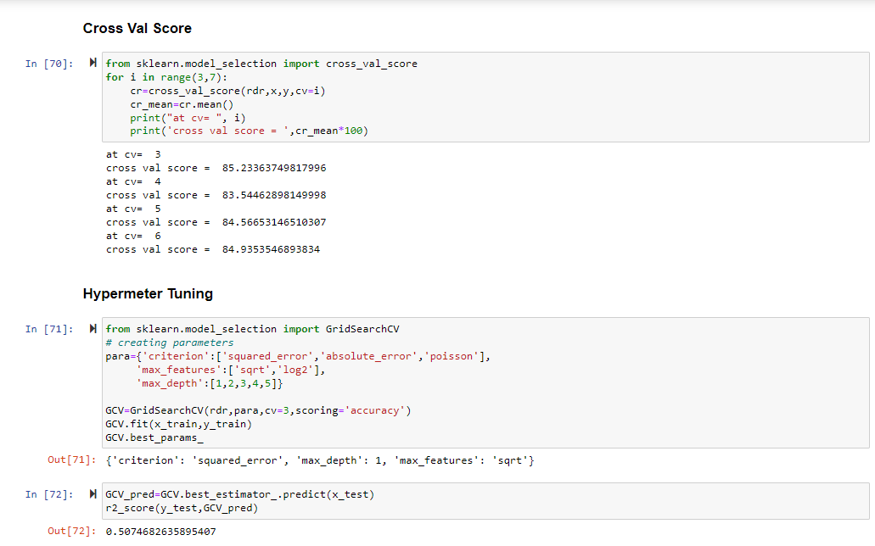
Cross Val Score & Hypermeter Tuning
Finding the cv at which the model runs the best.
Finding the parameters of the model whose accuracy we found the best at which it runs the best using the hypermeter tuning.

Slide 15
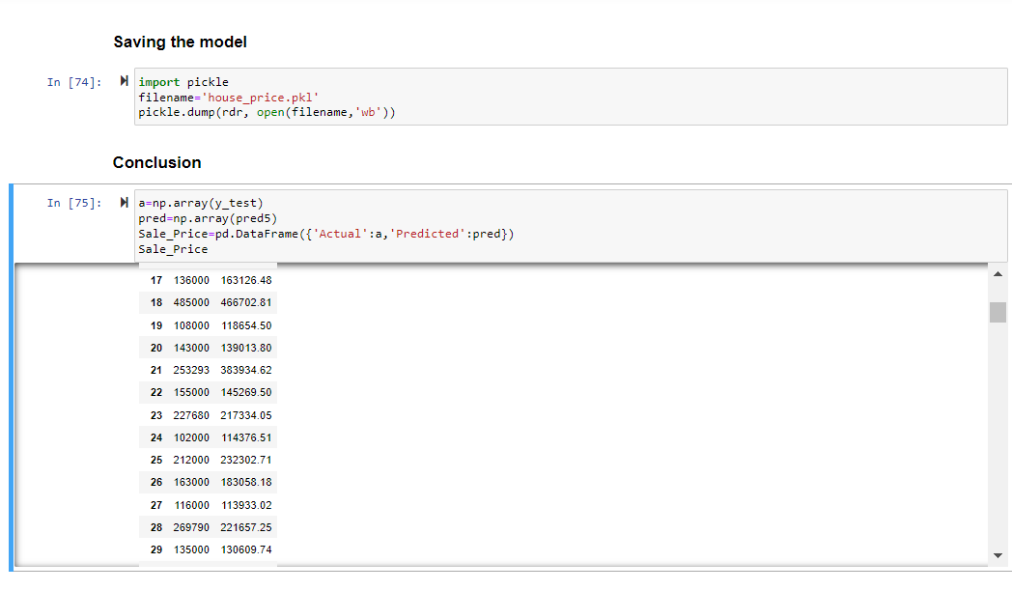
Saving the Model
After doing all the EDA process and find our best regression algorithm we will save that model for future predictions using the pickle algorithm.
We will conclude after comparing the actual & predicted values.

Slide 16
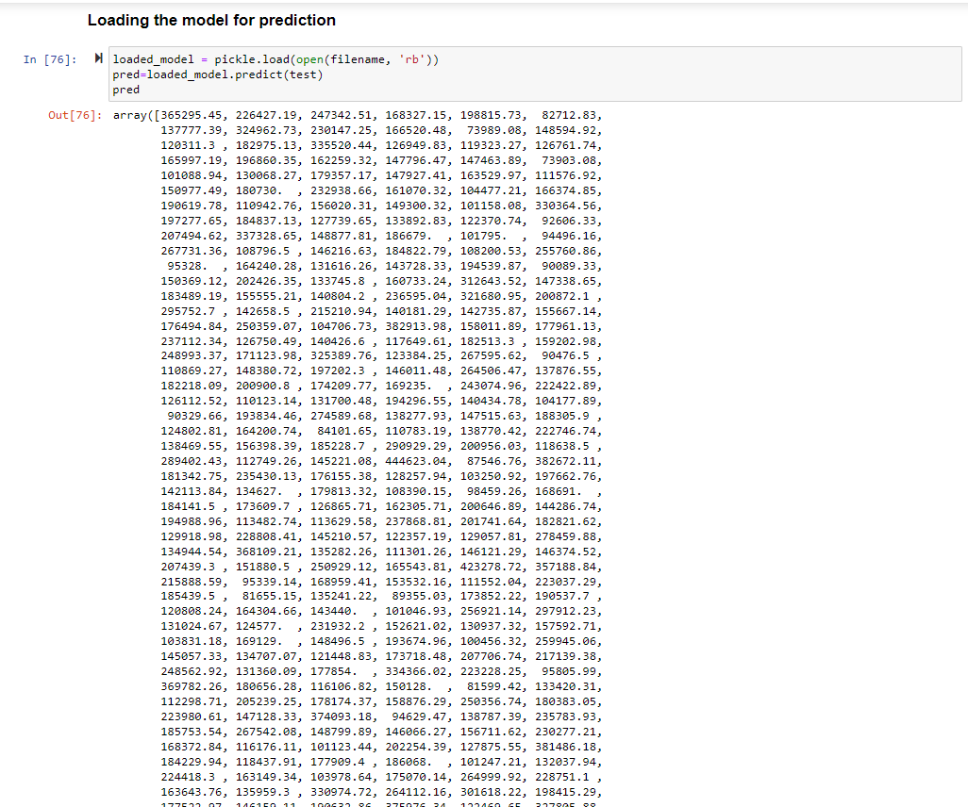
Now Let’s predict the Sale Price
With the help of our best machine learning model, let’s predict the sale prices of the houses based on the information provided in the test.csv dataset.
This prediction is not 100% accurate but yes it will provide a better vision to the company for thinking to enter into the Australian market.

Slide 17


